Slide 1
MDP

Slide 2
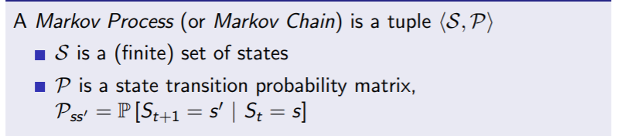
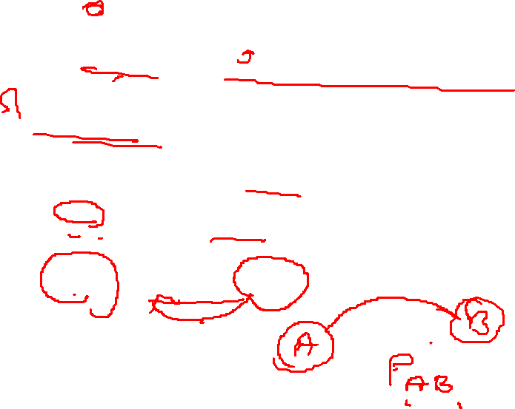
Markov Process
A Markov process is a memoryless random process, i.e. a sequence of random states S1, S2, ... with the Markov property

Slide 3
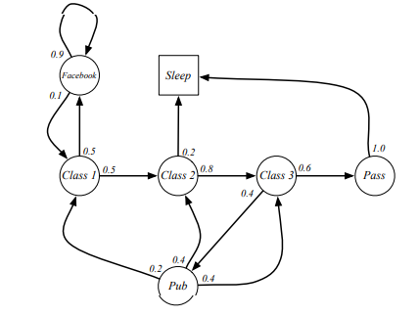
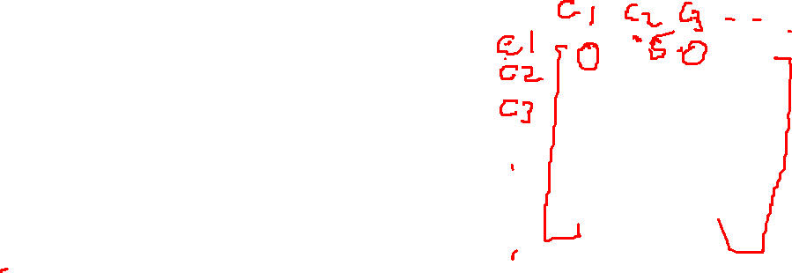

Slide 4
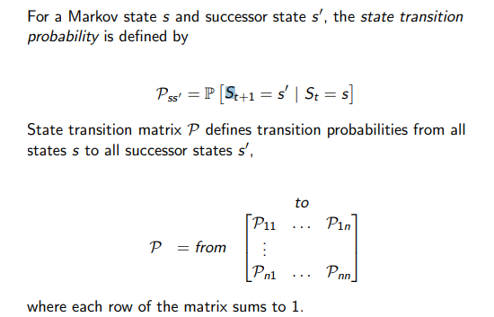

State transition matrix

Slide 5
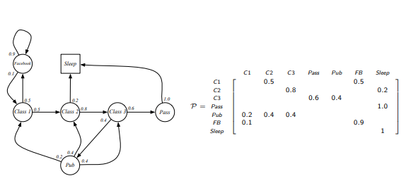

Slide 6
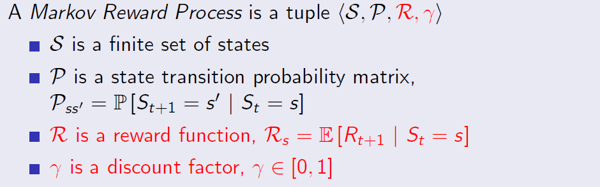
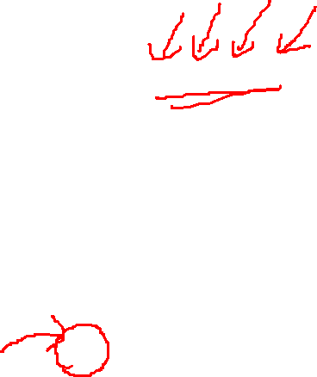
Markov reward process
Markov Reward process is a Markov chain with values

Slide 7
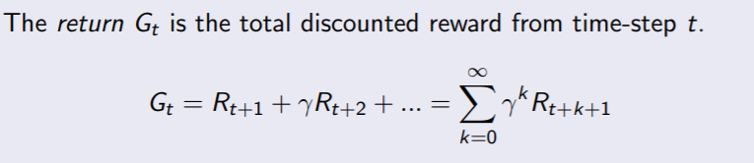
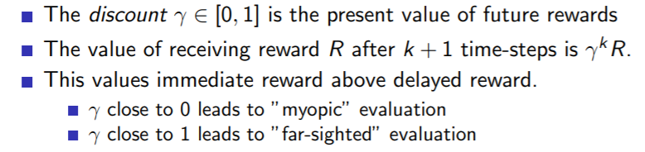
Return

Slide 8
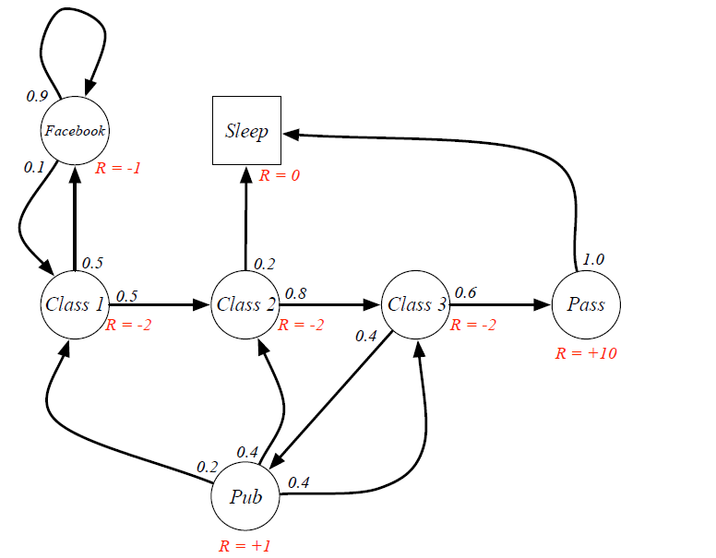

Slide 9
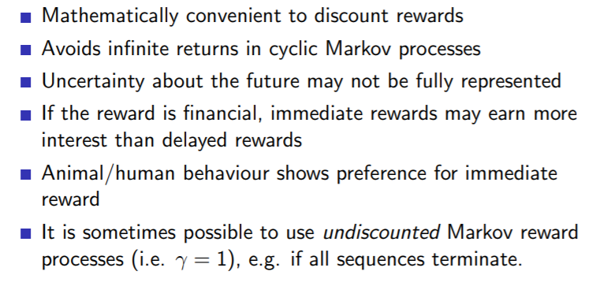
Why discounts?

Slide 10
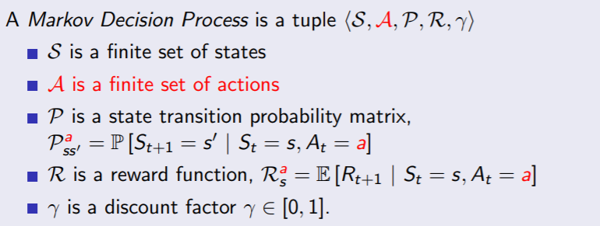

MDP
Differs from the Markov Chain in that it brings actions into play.
i.e, the next state is related not only to the current state itself but also to the actions taken in the current state.
MDP, some actions that correspond to a state can return rewards.

Slide 11
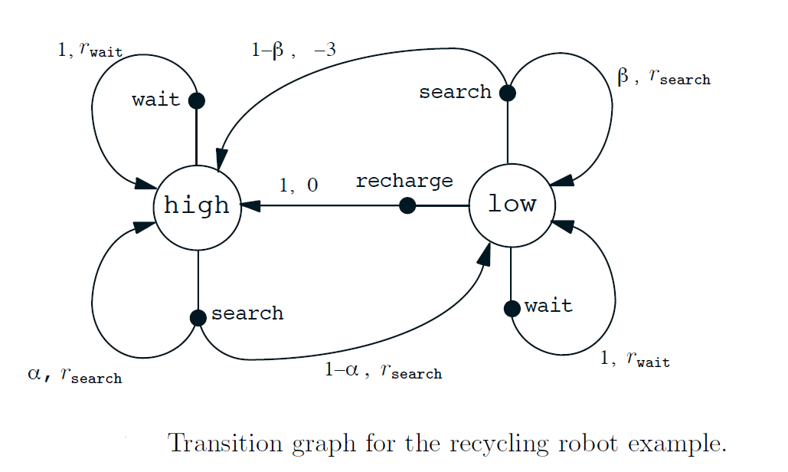
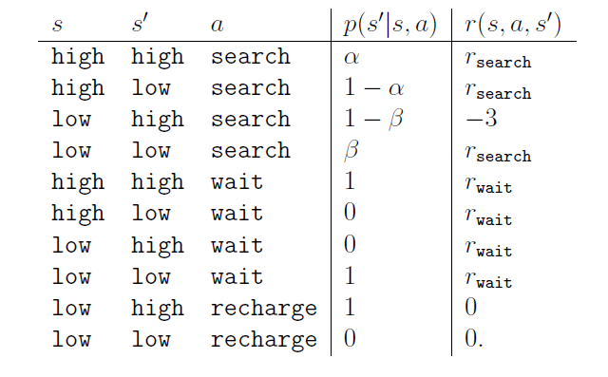
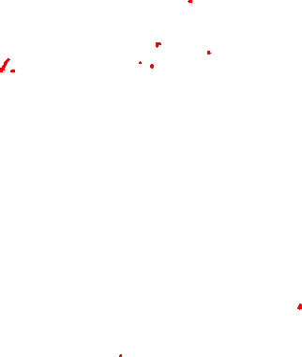

Slide 12
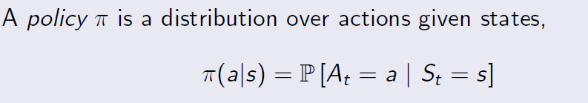
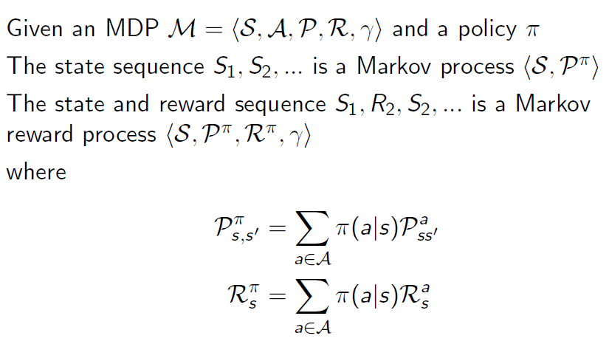
Policy

Slide 13
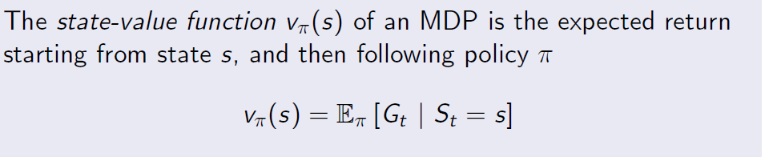
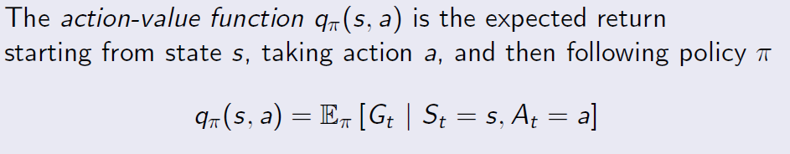
Policy

Slide 14
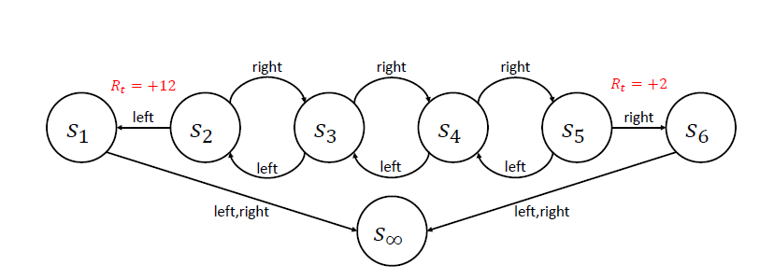
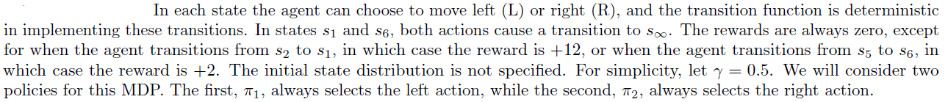
Example
Consider the following chain MDP with states s1, s2, ….s6 and s∞

Slide 15
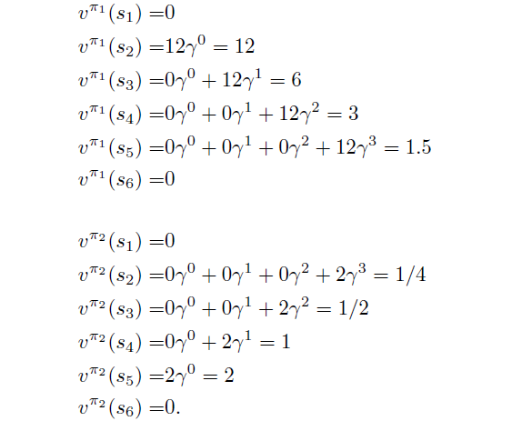

Slide 16
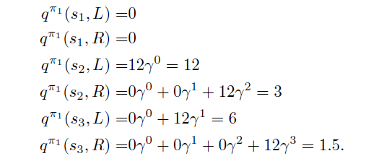

Slide 17
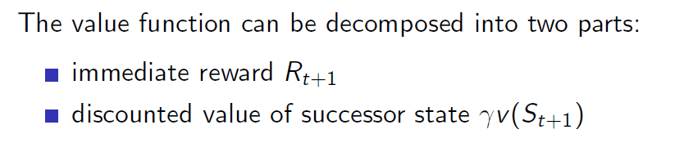
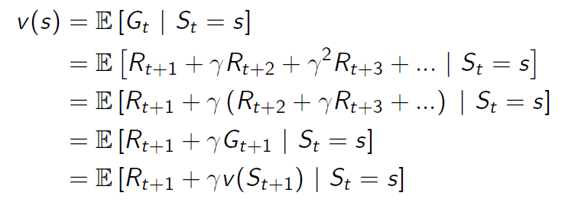
Bellman equation for reward function

Slide 18
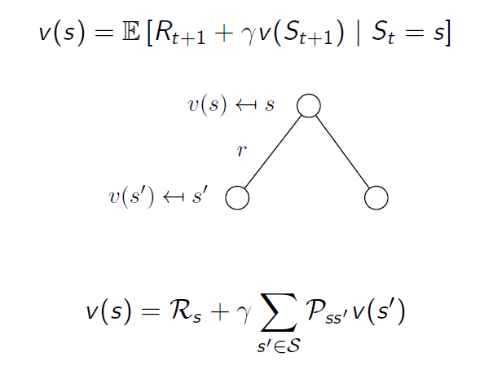
Bellman equation for value function

Slide 19
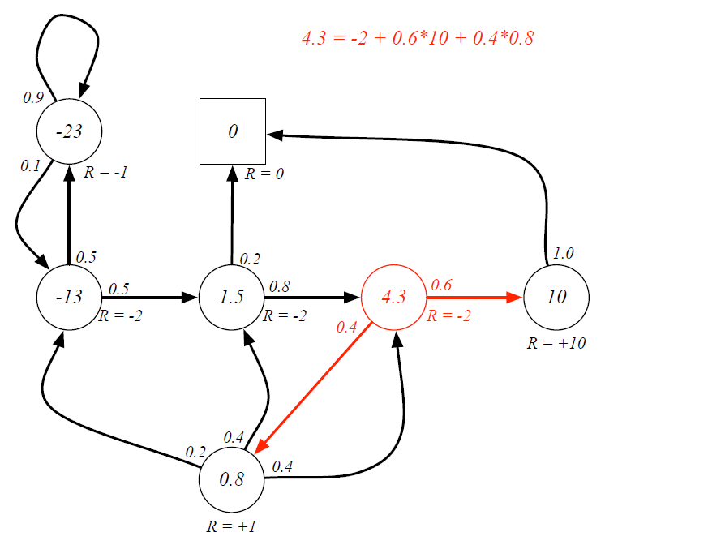

Slide 20
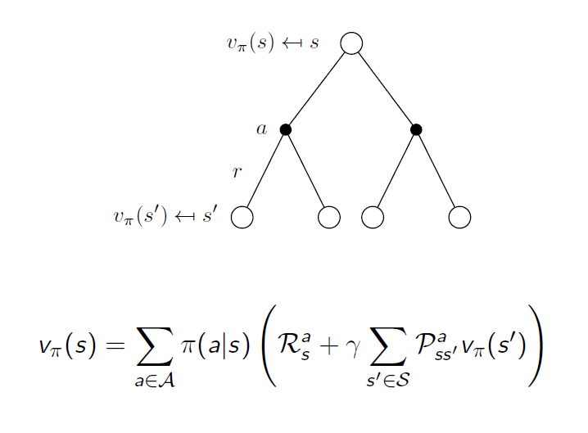
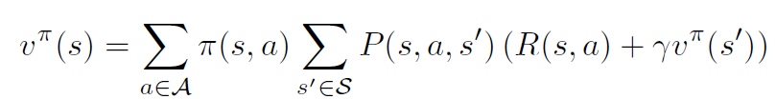
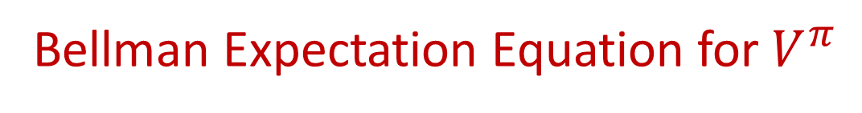
Bellman Expectation Equation for $V^{π}$

Slide 21
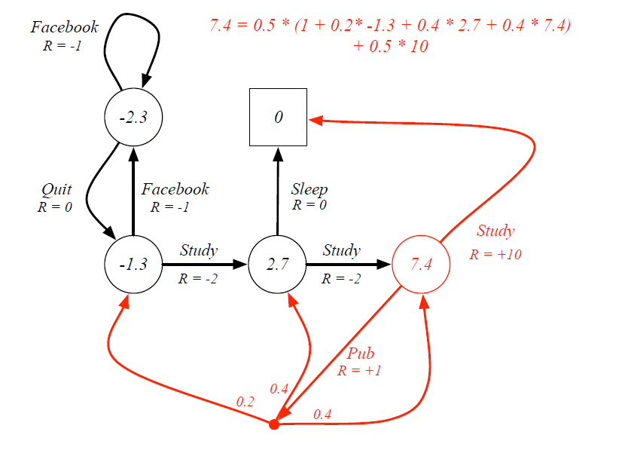

Slide 22
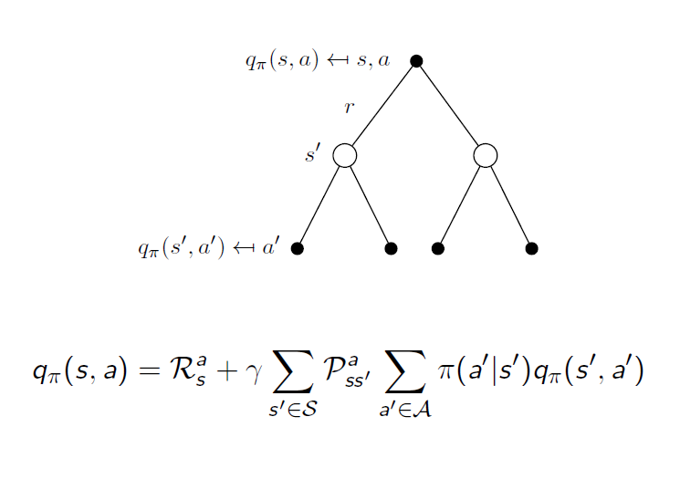
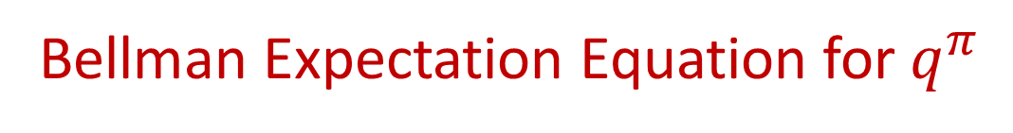
Bellman Expectation Equation for $q^{π}$

Slide 23
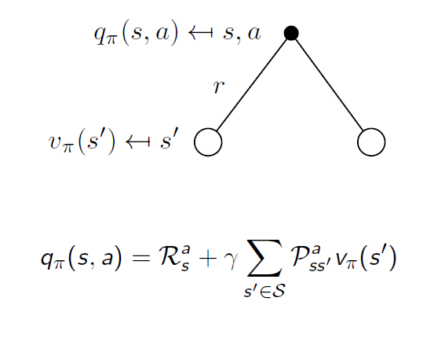
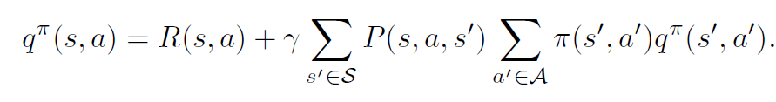
Bellman Expectation Equation for $q^{π}$

Slide 24
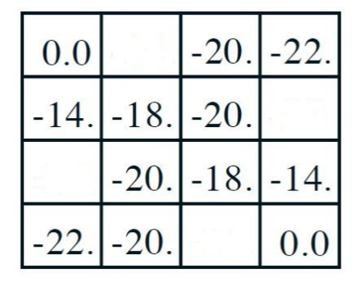
Consider a 4 X 4 grid world problem where the goal is to reach either the top left corner or the bottom right corner. The agent can choose from four actions {up, down, left, right} which deterministically cause the corresponding state transitions, except that actions that would take the agent off the grid leave the state unchanged. We model this as an undiscounted, episodic task, where the reward is -1 for all transitions. Suppose that the agent follows the equiprobable random policy. Given below is the partial value function for this problem. Calculate respectively, the missing values in the first and second row? (Hint: the Bellman equation must hold for every state.)
?

Slide 25
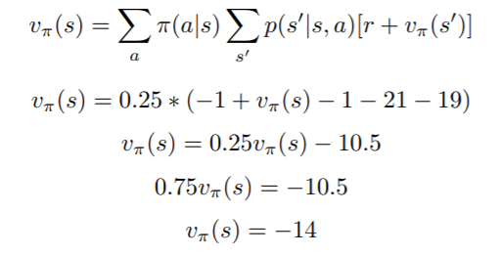
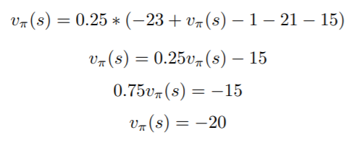
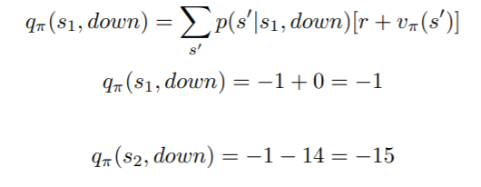
s1
s2

